Slide 1
Unit 4:Finite State Machines
Mealy and
Moore machines representation
Basic design steps
Finite state machine design, Sequence
detector moore and mealy, Serial
binary adder

Slide 2
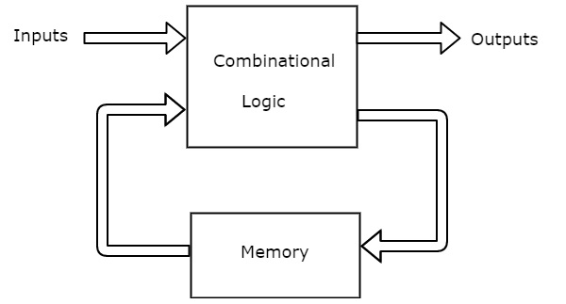
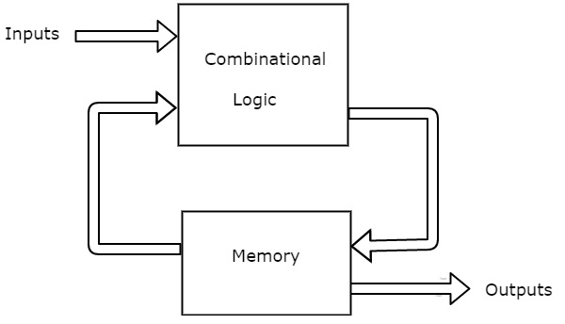
Finite State Machine
A synchronous sequential circuit is also called as Finite State Machine FSM, if it has finite number of states. There are two types of FSMs.
Mealy State Machine
Moore State Machine
Mealy State Machine: Mealy state machine, if outputs depend on both present inputs & present states.
Moore State Machine: Moore state machine, if outputs depend only on present states
Present state variables

Slide 3
State Diagram
A state diagram or a state transition diagram is a graphical representation among present state, the input, the next state and the output of the finite state sequential machine.
The states are labelled inside the circles & each circle corresponds to one state. Transitions between these states are represented with directed lines. Here, 0 / 0, 1 / 0 & 1 / 1 denotes input / output. - state diagram of Mealy state machine

Slide 4
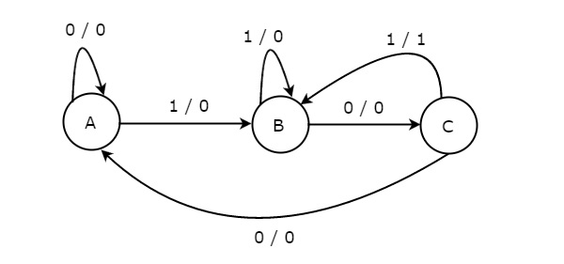
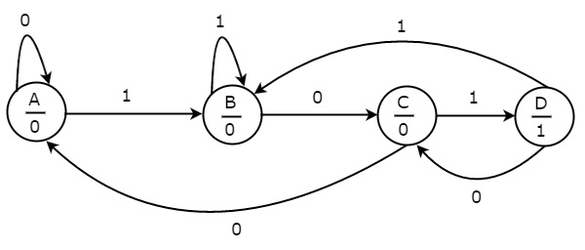
State Diagrams
The state diagram of Mealy state machine is shown in the following figure.
The state diagram of Moore state machine is shown in the following figure.
A, B & C States. These states are labelled inside the circles. Transitions between these states are represented with directed lines. Here, 0 / 0, 1 / 0 & 1 / 1 denotes input / output. there are two transitions from each state based on the value of input, x.
A, B, C & D. States and the respective outputs are labelled inside the circles. Input value is labeled on each transition. there are two transitions from each state based on the value of input, x.

Slide 5
State Table
The state table is a tabular representation of the relationship between the present state, the input, the next state, and the output.
State diagram and state table consists of the same information.

Slide 6
Transition and Output table
Obtained from state table
Excitationtable:

Slide 7
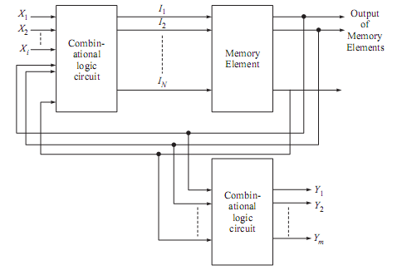
Synchronous Sequential Circuit Synchronous sequential circuits are also known as clocked sequential circuits
Moore Machine

Slide 8
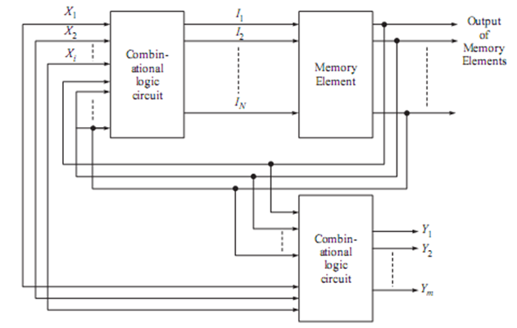
Synchronous Sequential Circuit
Mealy Machine

Slide 9
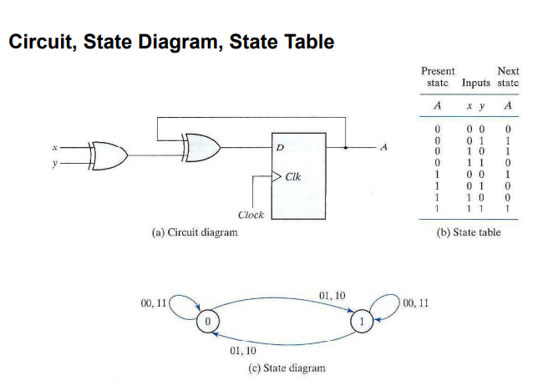

Slide 10
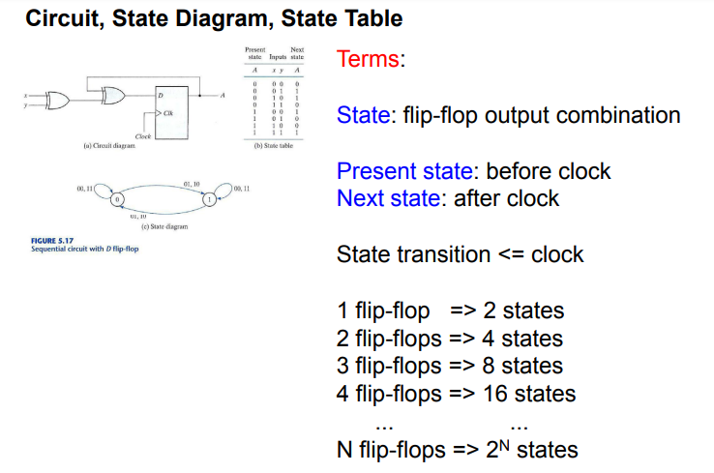
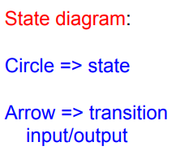
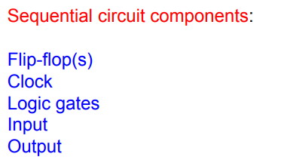

Slide 11
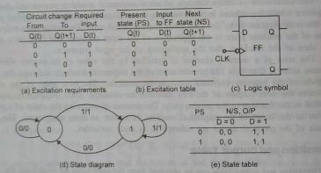
State Diagram is known as Mealy Model
D Flip Flop

Slide 12

Q(t+1) = D(t)
D Flip Flop

Slide 13
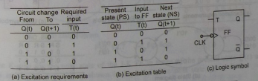

T Flip Flop

Slide 14
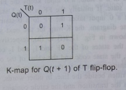


Slide 15
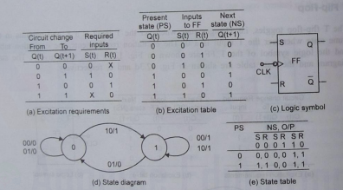
S-R Flip Flop

Slide 16



Slide 17
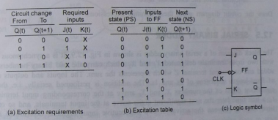
J-K Flip Flop

Slide 18

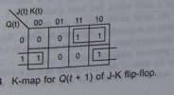

Slide 19
Serial Binary Adder
Step1: word statement of the problem: the block diagram of a serial binary adder is shown in fig.
it is a synchronous circuit with two input terminals designated X1and X2 which carry the two binary numbers to be added and one output terminal Z which represents the sum.
The inputs and outputs consist of fixed-length sequences 0s and 1s.the output of the serial Zi at time ti is a function of the inputs X1(ti) and X2(ti) at that time ti-1 and of carry which had been generated at ti1.
The carry which represent the past history of the serial adder may be a 0 or 1.
The circuit has two states. If one state indicates that carry from the previous addition is a 0, the other state indicates that the carry from the previous addition is a 1

Slide 20
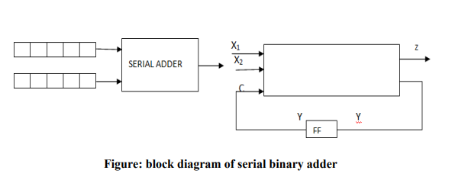
Step2 and 3: state diagram and state table: let a designate the state of the serial adder at ti if a carry 0 was generated at ti-1, and let b designate the state of the serial adder at ti if carry 1 was generated at ti-1 .the state of the adder at that time when the present inputs are applied is referred to as the present state(PS) and the state to which the adder goes as a result of the new carry value is referred to as next state(NS). The behavior of serial adder may be described by the state diagram and state table.

Slide 21

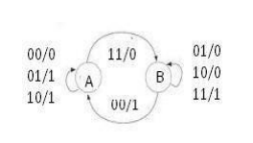
Figures: serial adder state diagram and state table
If the machine is in state A, i.e., carry from the previous addition is a 0, inputs X1=0 and X2=0 gives sum, 0 and carry 0. So the machine remains in state A and outputs a 0.
Inputs X1=1 and X2=0 gives sum, 1 and carry 0, So the machine remains in state A and outputs a 1.
Inputs X1=0 and X2=1 gives sum1 and carry 0. So the machine goes to state A and outputs a 1.
Inputs X1=1 and X2=1 gives sum, 0 and carry 1. So the machine goes to state B and outputs a 0. The state table also gives the same information.

Slide 22
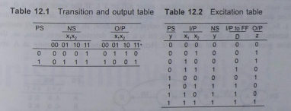
If the machine is in state B, i.e., carry from the previous addition is a 1, inputs X1=0 and X2=1 gives sum, 0 and carry 1. So the machine remains in state B and outputs a 0. Inputs X1=1 and X2=0 gives sum, 0 and carry 1. So the machine remains in state B and outputs a 0. Inputs X1=1 and X2=1 gives sum, 1 and carry 0. So the machine remains in state B and outputs a 1. Inputs X1=0 and X2=0 gives sum, 1 and carry 0. So the machine goes to state A and outputs a 1. The state table also gives the same information.
Step4: state assignment and transition and output table: The states, A=0 and B=1 have already been assigned. So, the transition and output table is as shown.

Slide 23
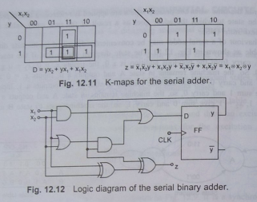
Step 5-To write the excitation table, select the memory element . Obtain the minimal expressions for D and Z in terms of y,x1 and x2 by using k map as shown in fig

Slide 24
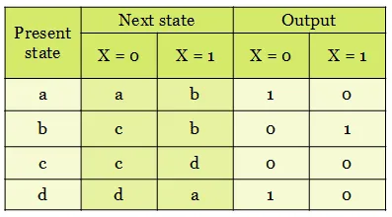
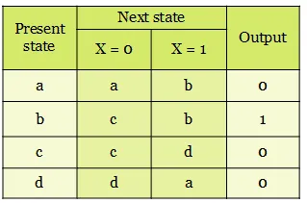
State table for Mealy state machine model
State table for Moore state machine model
Since, in Moore state machine model, the output depends only on the present state, the last column has only output. Criterion criteria

Slide 25
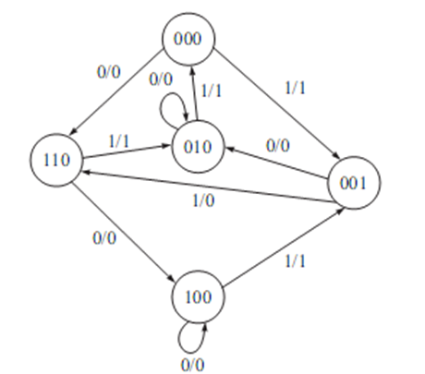
Design the sequential circuit for the state diagram shown in Fig. given using J-K flip-flops
Step 1: State table for state diagram
Present state |  |  | Next state |  |  |  |  |  | Output
 |  |  | X=0 |  |  | X=1 |  |  | X=0 | X=1
Q₂ | Q₁ | Q₀ | Q₂ | Q₁ | Q₀ | Q₂ | Q₁ | Q₀ | Y | Y
0 | 0 | 0 | 1 | 1 | 0 | 0 | 0 | 1 | 0 | 1
0 | 0 | 1 | 0 | 1 | 0 | 1 | 0 | 0 | 0 | 1
0 | 1 | 0 | 0 | 1 | 0 | 0 | 0 | 0 | 0 | 1
1 | 0 | 0 | 1 | 0 | 0 | 0 | 0 | 1 | 0 | 1
1 | 1 | 0 | 1 | 0 | 0 | 0 | 1 | 0 | 0 | 1
Step 2: State reduction:
From the state table; it is observed that all the states are different; there is no possibility to reduce the state table.

Slide 26
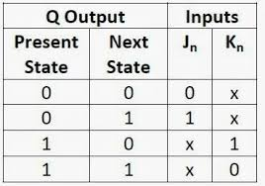
Step 3: Excitation table for the given state diagram using J-K flip-flop
Present state |  |  | Input | Next state |  |  | Output | Input of the flip-flops
Q₂ | Q₁ | Q₀ | X | Q₂ | Q₁ | Q₀ | Y | J₀ | K₀ | J₁ | K ₁ | J₂ | K₂
0 | 0 | 0 | 0 | 1 | 1 | 0 | 0 | 0 | X | 1 | X | 1 | X
0 | 0 | 1 | 0 | 0 | 1 | 0 | 0 | X | 1 | 1 | X | 0 | X
0 | 1 | 0 | 0 | 0 | 1 | 0 | 0 | 0 | X | X | 0 | 0 | X
1 | 0 | 0 | 0 | 1 | 0 | 0 | 0 | 0 | X | 0 | X | X | 0
1 | 1 | 0 | 0 | 1 | 0 | 0 | 0 | 0 | X | X | 1 | X | 0
0 | 0 | 0 | 1 | 0 | 0 | 1 | 1 | 1 | X | 0 | X | 0 | X
0 | 0 | 1 | 1 | 1 | 0 | 0 | 1 | X | 1 | 0 | X | 1 | X
0 | 1 | 0 | 1 | 0 | 0 | 0 | 1 | 0 | X | X | 1 | 0 | X
1 | 0 | 0 | 1 | 0 | 0 | 1 | 1 | 1 | X | 0 | X | X | 1
1 | 1 | 0 | 1 | 0 | 1 | 0 | 1 | 0 | X | X | 0 | X | 1

Slide 27
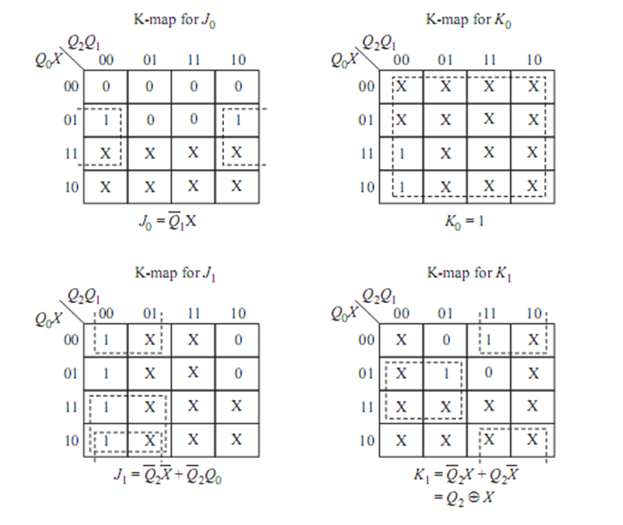
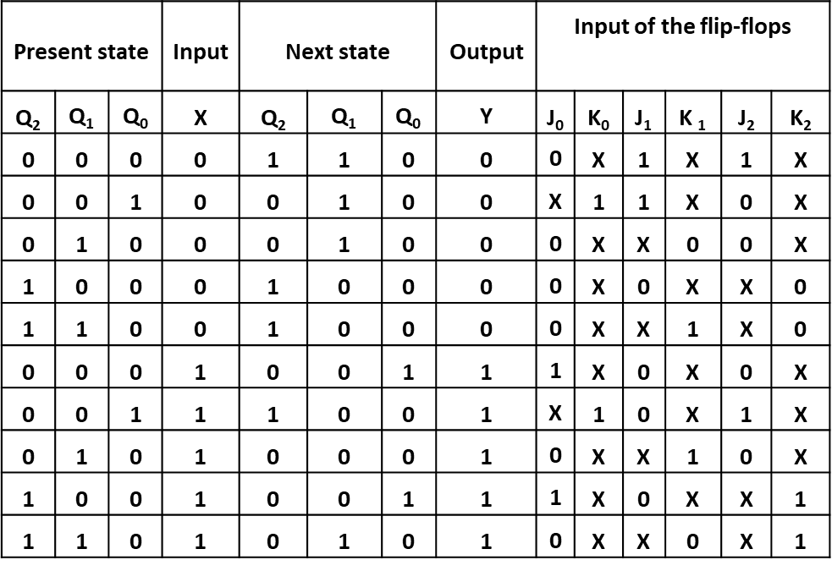
Step 4: K Maps for Flipflops inputs

Slide 28
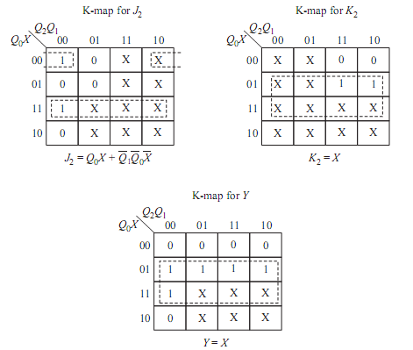
Step 4: K Maps for Flipflops inputs

Slide 29
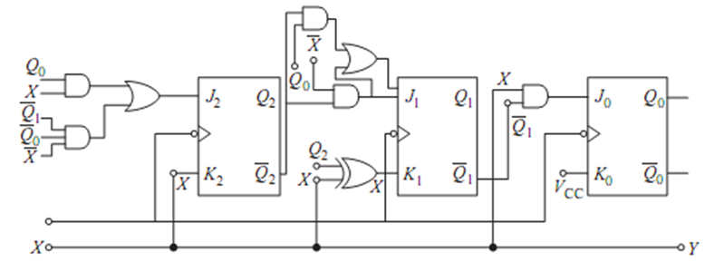

Step 5: logic diagram

Slide 30
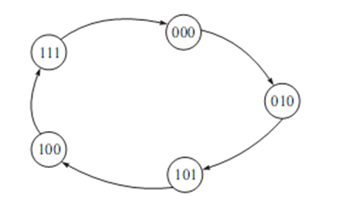
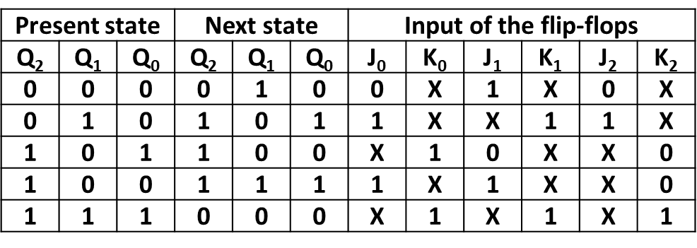
Design the circuit to generate the sequence 0→2→5→4→7 Step 1: State diagram
Step 2: State table for the State diagram
Present state |  |  | Next state
Q₂ | Q₁ | Q₀ | Q₂ | Q₁ | Q₀
0 | 0 | 0 | 0 | 1 | 0
0 | 1 | 0 | 1 | 0 | 1
1 | 0 | 1 | 1 | 0 | 0
1 | 0 | 0 | 1 | 1 | 1
1 | 1 | 1 | 0 | 0 | 0
Step 3: State reduction:
From the state table it is observed that all the states are different, there is no possibility to reduce the state table.
Step 4:Excitation table for the state table using J-K flip-flop / Transition Table

Slide 31
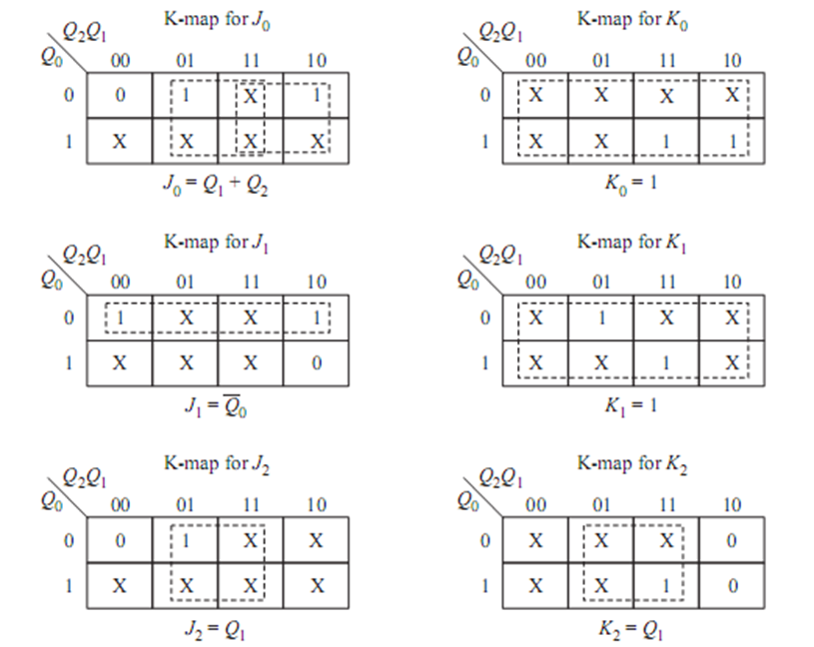

Slide 32
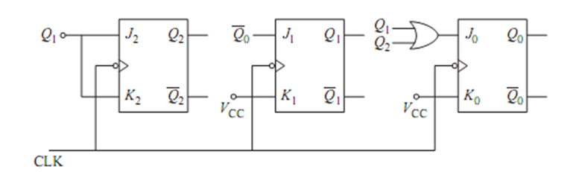
Step 5: Logic diagram

Slide 33
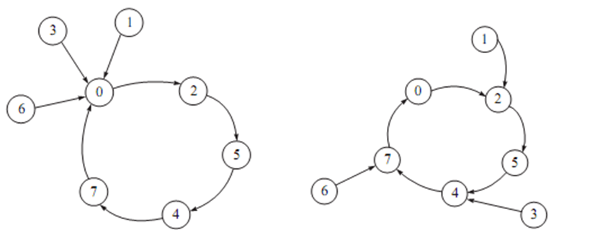
Lockout condition:
designed to generate the sequence 0-2-5-4-7-0, the states 1, 3 and 6 are the unused states. If by chance the sequence generator to find it self in any one of the unused states, the next state is unknown. It may possible that the sequence generator go from one unused state to another unused states, it never arrive at the used state. The circuit is said to be locked. To avoid the condition of lockout, there is need to design the circuit such that, when the circuit found in unused state the next state should be known and it must be used state. The state diagrams of sequence generate to generate the sequence 0-2-5-4-7-0 with lock out condition as shown

Slide 34
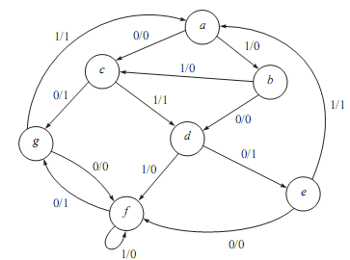
Analysis Of Clocked Sequential Circuit
Step 1:State table for state diagram
Present state | Next state |  | Output
 | X=0 | X=1 | X=0 | X=1
a | c | b | 0 | 0
b | d | c | 0 | 0
c | g | d | 1 | 1
d | e | f | 1 | 0
→e | f | a | 0 | 1
f | g | f | 1 | 0
→g | f | a | 0 | 1

Slide 35
The states ‘e’ and ‘g’ are equivalent because the next state and outputs are same for the input X is equal to 0 as well as X is equal to 1; and hence ‘g’ is replaced by ‘e’ and the state ‘g’ is removed from the table.
Step 2: State Reduction
Present state | Next state |  | Output
 | X=0 | X=1 | X=0 | X=1
a | c | b | 0 | 0
b | d | c | 0 | 0
c | (g)e | d | 1 | 1
→d | e | f | 1 | 0
e | f | a | 0 | 1
→f | (g)e | f | 1 | 0
Present state | Next state |  | Output
 | X=0 | X=1 | X=0 | X=1
a | c | b | 0 | 0
b | d | c | 0 | 0
c | e | d | 1 | 1
d | e | (f)d | 1 | 0
e | (f)d | a | 0 | 1
The state ‘c’ and ‘d’ are not equivalent because next state is same for input X is equal to 0 and X is equal to 1, but outputs are not same.
The states ‘d’ and ‘f’ are equivalent because the next state and output are same for the input X is equal to 0 and X is equal to 1;and hence ‘f’ is replaced by ‘d’ and the state ‘f’ is removed from the table

Slide 36
Step 4: Transition/ Excitation Table
Step 3: State Assignment
Variable Assign value
a 000
b 001
c 010
d 011
e 100
Present state | Next state |  | Output
 | X=0 | X=1 | X=0 | X=1
Q1Q2Q3 | Q1Q2Q3 | Q1Q2Q3
000 | 010 | 001 | 0 | 0
001 | 011 | 010 | 0 | 0
010 | 100 | 011 | 1 | 1
011 | 100 | 011 | 1 | 0
100 | 011 | 000 | 0 | 1
 | Input | Present state | Next State | Inputs to F/F | Output
 |  |  |  |  | X=0
 | x | Q1Q2Q3 | Q1Q2Q3 | D1D2D3
0 | 0 | 000 | 010 | 010 | 0
1 | 0 | 001 | 011 | 011 | 0
2 | 0 | 010 | 100 | 100 | 1
3 | 0 | 011 | 100 | 100 | 1
4 | 0 | 100 | 011 | 011 | 0
8 | 1 | 000 | 001 | 001 | 0
9 | 1 | 001 | 010 | 010 | 0
10 | 1 | 010 | 011 | 011 | 1
11 | 1 | 011 | 011 | 011 | 0
12 | 1 | 100 | 000 | 000 | 1

Slide 37
Step 5: K Maps

Slide 38
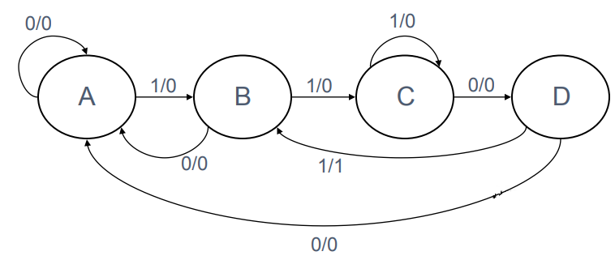
Example
Design a sequential circuit to recognize the input sequence 1101.
That is, output 1 if the sequence 1101 has been read, output 0 otherwise.

Slide 39
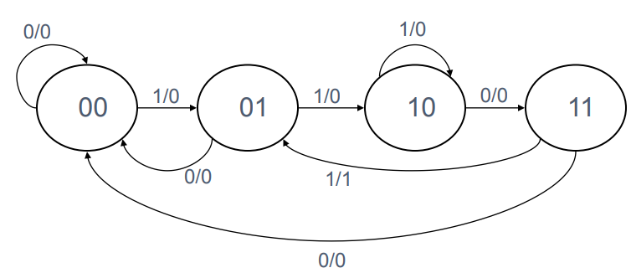
Assign States
4 states, so we need 2 bits

Slide 40
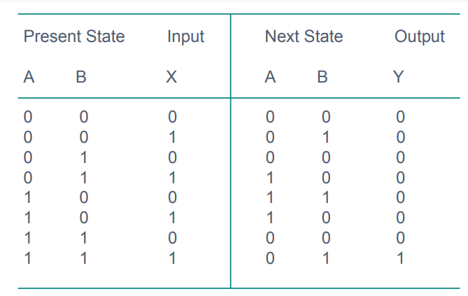
State Table

Slide 41
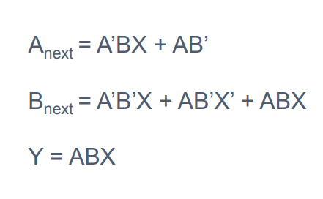
Input Equations

Slide 42
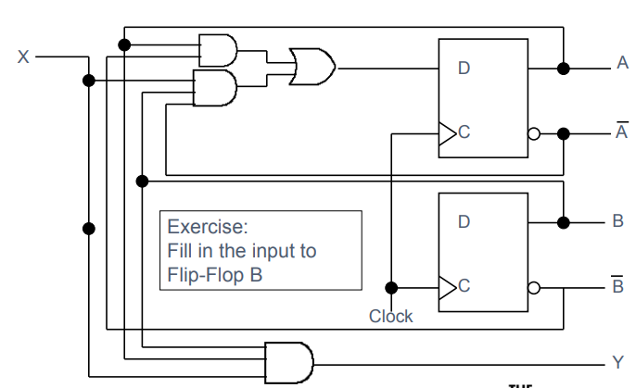
Circuit Diagram

Slide 43
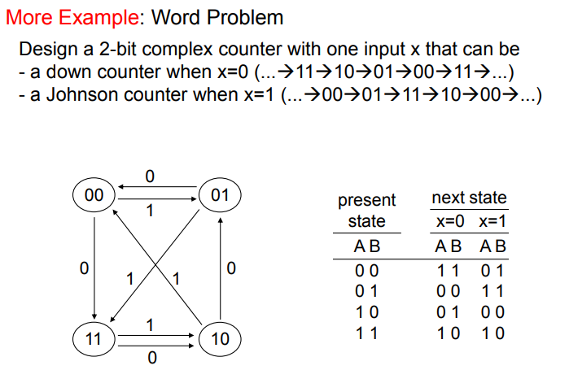
A1 batch(PBL Activity)

Slide 44
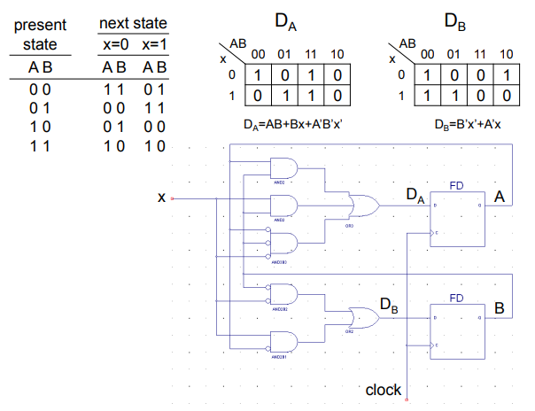

Slide 46
A2 batch: PBL2:
Design a 3-bit gray code Counter

Slide 47
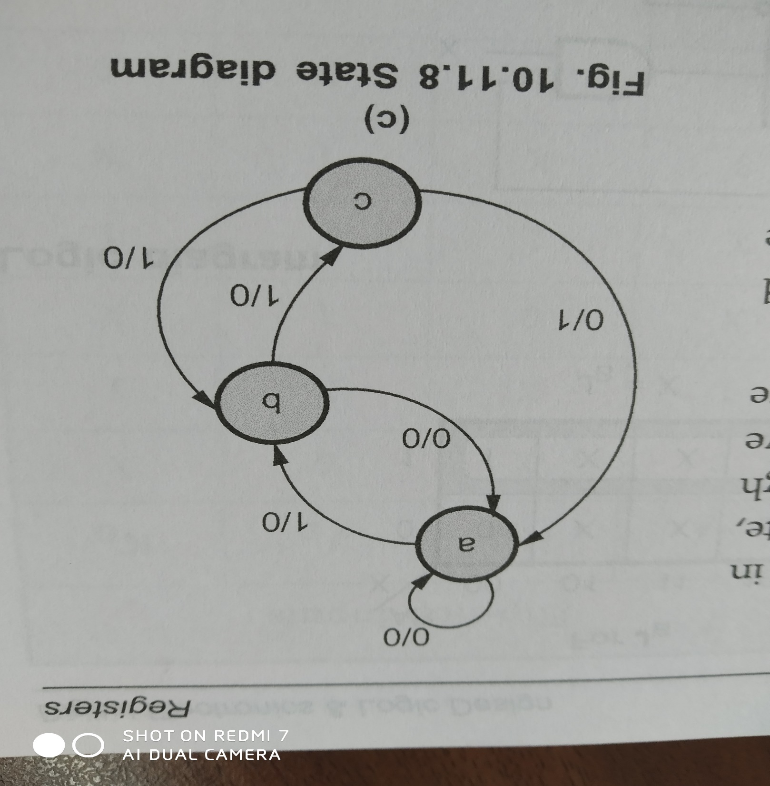

Slide 48
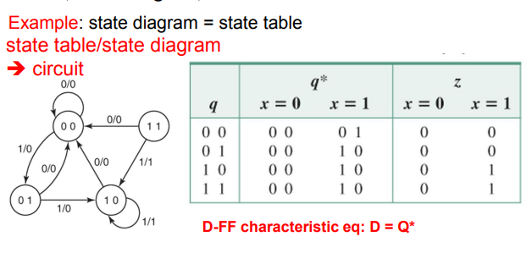
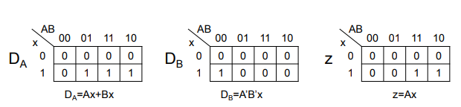

Slide 49
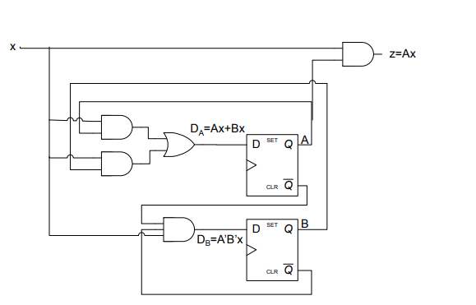

Slide 50
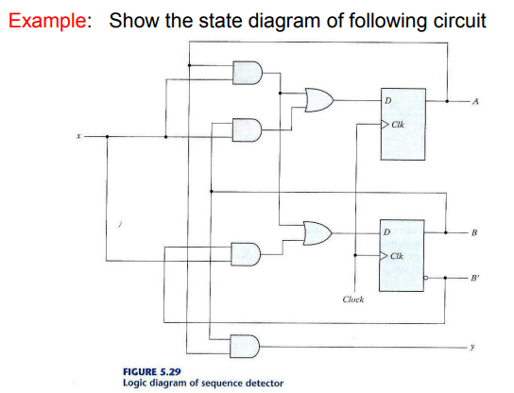


Slide 51
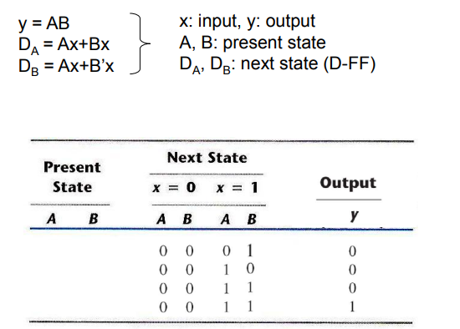
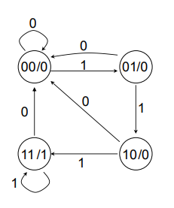

Slide 52
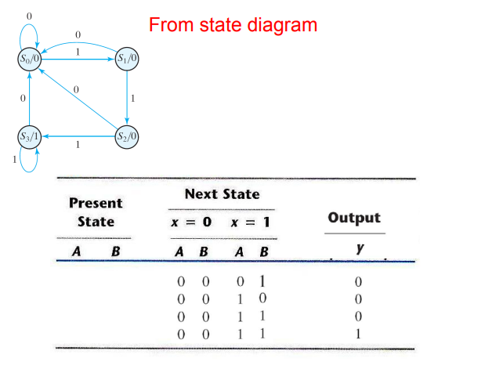

Slide 53
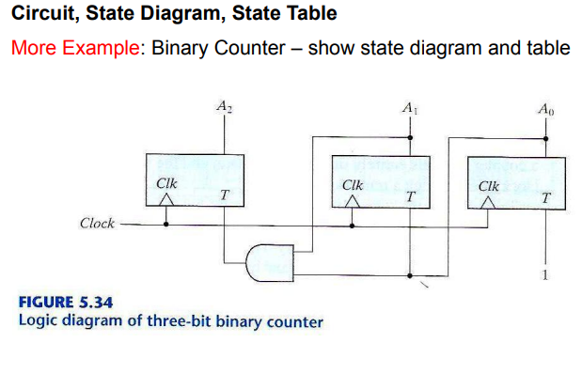

Slide 54


Slide 55


Slide 56


Slide 57


Slide 58


